Slide 1
Edge Computing Architecture for Mobile Crowdsensing
Prem Jyothi
Class no:46
S7R
Dept of CSE, MACE, Kothamangalam
October 10, 2018

Slide 2
CONTENTS
Edge Computing Architecture for Mobile Crowdsensing
Introduction
MCS Marketplace
Smart neighborhood use case
Existing method
Proposed method
MEC paradigm
Functional MCS architecture
MEC Reference Architecture
Applications
Challenges
Conclusion

Slide 3
INTRODUCTION
Edge Computing Architecture for Mobile Crowdsensing
What is Mobile Crowdsensing(MCS)?
Large user base
Rich source of information
Mobile devices with built-in sensors
User mobility

Slide 4
INTRODUCTION(contd.)
Edge Computing Architecture for Mobile Crowdsensing
What is Edge Computing?
Move computation to network edge
Basic idea- performing processing tasks close to customer
Enables third parties to run services at edge

Slide 5
MCS MARKETPLACE
Edge Computing Architecture for Mobile Crowdsensing
Involves requesters and workers.
Requester creates a new task.
MCS service responsible for finding eligible workers.
Produced data delivered to MCS service.
Data production process has to be controlled.

Slide 6
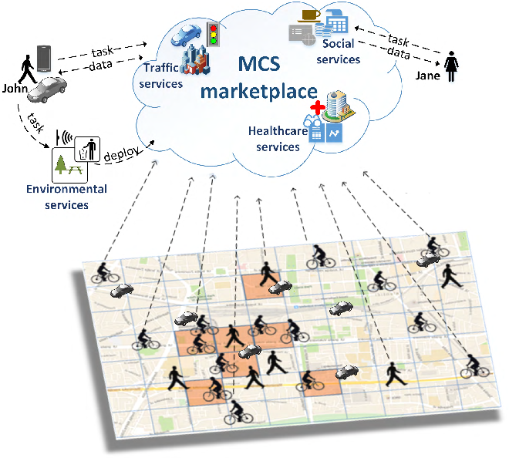
SMART NEIGHBORHOOD USE CASE
Edge Computing Architecture for Mobile Crowdsensing
Courtesy:https://ieeexplore.ieee.org/document/8272334

Slide 7
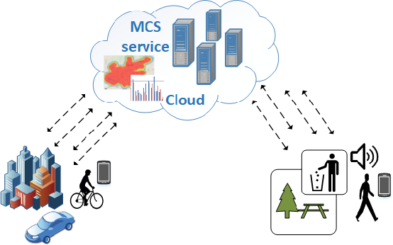
CLOUD-BASED MCS ARCHITECTURE
Edge Computing Architecture for Mobile Crowdsensing
Courtesy:https://www.sciencedirect.com/science/article/pii/S2352864817301335

Slide 8
EXISTING METHOD
Edge Computing Architecture for Mobile Crowdsensing
Significant load on mobile network.
Creates increased traffic to cloud servers.
Computationally expensive.
Increased latency.
Privacy threat.

Slide 9
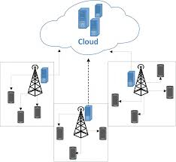
MCS ARCHITECTURE POWERED BY MEC INFRASTRUCTURE
Edge Computing Architecture for Mobile Crowdsensing
Courtesy:https://ieeexplore.ieee.org/document/8272334

Slide 10
PROPOSED SCHEME
Edge Computing Architecture for Mobile Crowdsensing
Partitioning of problem space.
Computation offloading.
Reduced computational complexity.
Decreased latency.
Reduced privacy threats.

Slide 11
MEC PARADIGM
Edge Computing Architecture for Mobile Crowdsensing
MCS tasks distributed to ME servers.
ME servers responsible for subset of tasks.
MCS service builds partial data model.
MCS cloud server creates global data model.

Slide 12
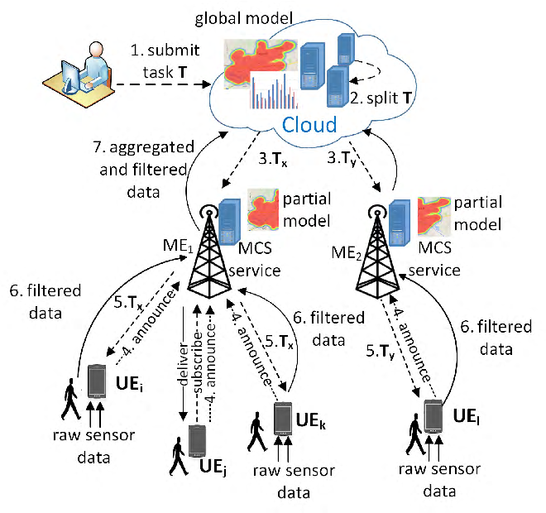
COMMUNICATION FLOW
Edge Computing Architecture for Mobile Crowdsensing
Courtesy:https://ieeexplore.ieee.org/document/8272334

Slide 13
MCS CHARACTERISTIC FEATURES
Edge Computing Architecture for Mobile Crowdsensing
Data preprocessing
Sampling mode
Sensing scope
Device discovery

Slide 14
MCS CHARACTERISTIC FEATURES(contd.)
Edge Computing Architecture for Mobile Crowdsensing
User reputation
Real-time processing
Security and privacy

Slide 15
FUNCTIONAL MCS ARCHITECTURE
Edge Computing Architecture for Mobile Crowdsensing
Four-layered functional architecture.
User Equipment
Edge Computing Layer
Cloud Computing Layer
Applications

Slide 16
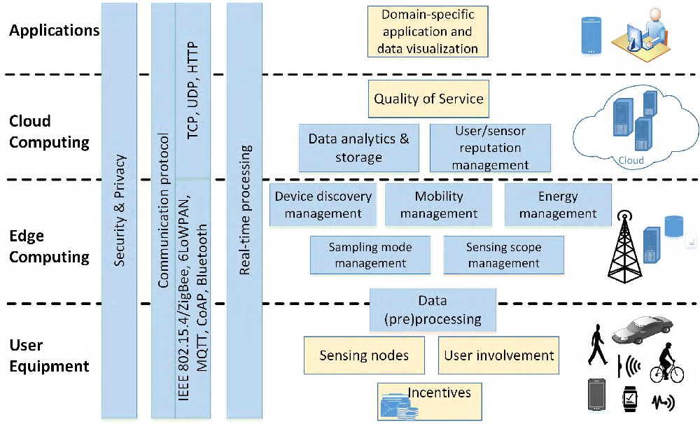
FUNCTIONAL MCS ARCHITECTURE
Edge Computing Architecture for Mobile Crowdsensing
Courtesy:https://ieeexplore.ieee.org/document/8272334

Slide 17
MEC REFERENCE ARCHITECTURE
Edge Computing Architecture for Mobile Crowdsensing
Identifies functional entities at host and system level.
Reference points enables communication between entities.
ME Host Level
ME host- ME platform and Virtualization Infrastructure.
ME Platform Manager
Virtualisation Infrastructure Manager

Slide 18
MEC REFERENCE ARCHITECTURE(Contd...)
Edge Computing Architecture for Mobile Crowdsensing
ME System Level
CFS Portal
Operation Support System(OSS)
ME Orchestrator(MEO)

Slide 19
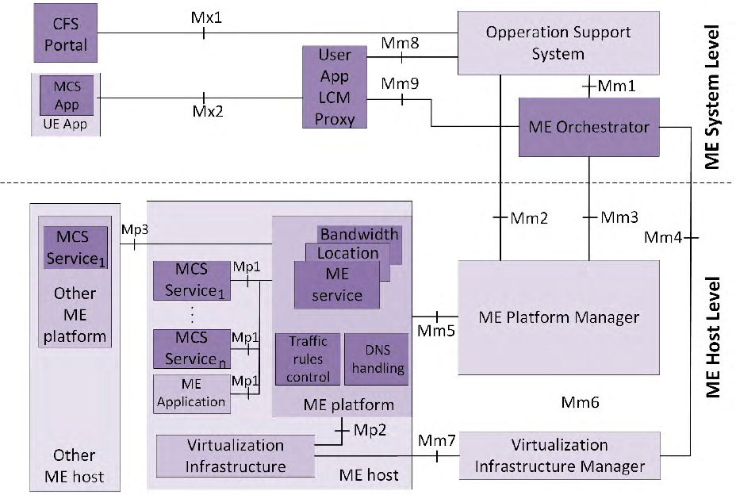
MEC REFERENCE ARCHITECTURE
Edge Computing Architecture for Mobile Crowdsensing
Courtesy:https://ieeexplore.ieee.org/document/8272334

Slide 20
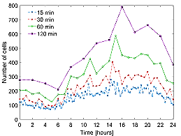
EVALUATION
Number of active MEC cells during a single day
Courtesy:https://ieeexplore.ieee.org/document/8272334

Slide 21
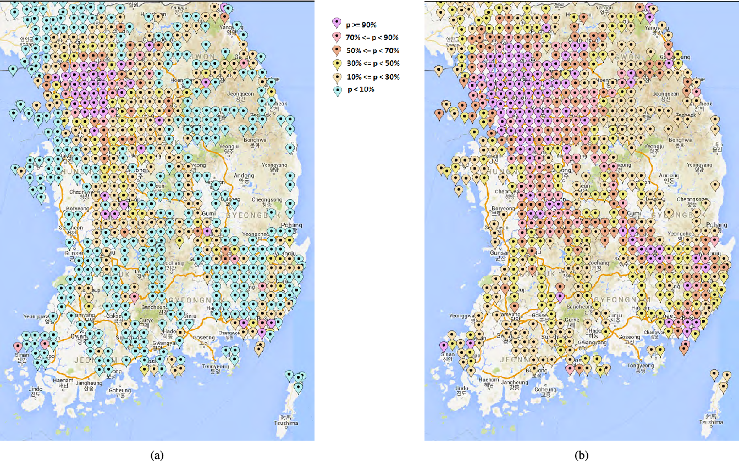
Courtesy:https://ieeexplore.ieee.org/document/8272334
15 minute time slots
120 minute time slots

Slide 22
APPLICATIONS
Edge Computing Architecture for Mobile Crowdsensing
Environmental Monitoring
Traffic Monitoring
Healthcare
Social Services

Slide 23
CHALLENGES
Interoperability
Enriched user context
Orchestration of MCS services
Task scheduling

Slide 24
CONCLUSION
Edge Computing Architecture for Mobile Crowdsensing
Edge computing decentralizes MCS services.
MCS services in close proximity of user.
Increased quality of service.
Reduced latency.

Slide 25
REFERENCES
Edge Computing Architecture for Mobile Crowdsensing
B. Guo, C. Chen, D. Zhang, Z. Yu, and A. Chin, ``Mobile crowd sensing and computing: When participatory sensing meets participatory social media,'' IEEE Commun. Mag., vol. 54, no. 2, pp. 131137, Feb. 2016.
N. D. Lane, E. Miluzzo, H. Lu, D. Peebles, T. Choudhury, and A. T. Campbell, ``A survey of mobile phone sensing,'' IEEE Commun. Mag., vol. 48, no. 9, pp. 140150, Sep. 2010.
A. Antoni¢, M. Marjanovi¢, K. Pripuºi¢, and I. P. .arko, ``A mobile crowdsensing ecosystem enabled by CUPUS: Cloud-based publish/subscribe middleware for the Internet of Things,'' Future Generat. Comput. Syst.,vol. 56, pp. 607622, Mar. 2016.
R. Ben Messaoud, Z. Rejiba, and Y. Ghamri-Doudane, ``An energy-aware end-to-end Crowdsensing platform: Sensarena,'' in Proc. 13th IEEE Annu. Consum. Commun. Netw. Conf. (CCNC), Jan. 2016, pp. 284285.
gW. Sherchan, P. P. Jayaraman, S. Krishnaswamy, A. Zaslavsky, S.Loke, and A. Sinha, ``Using on-the-move mining for mobile crowdsensing,'‘ in Proc. IEEE 13th Int. Conf. Mobile Data Manage., Jul. 2012,pp. 115-124.

Slide 26
REFERENCES(Contd..)
Edge Computing Architecture for Mobile Crowdsensing
D. Sabella, A. Vaillant, P. Kuure, U. Rauschenbach, and F. Giust, ``Mobileedge
computing architecture: The role of MEC in the Internet of Things,'‘ IEEE
Consum. Electron. Mag., vol. 5, no. 4, pp. 8491, Oct. 2016.
P. Mach and Z. Becvar, ``Mobile edge computing: A survey on architecture and computation ofoading,'' IEEE Commun. Surveys Tuts., vol. 19, no. 3, pp. 16281656, 3rd Quart., 2017.
F. Ye, R. Ganti, R. Dimaghani, K. Grueneberg, and S. Calo, ``MECA: Mobile edge capture and analysis middleware for social sensing applications,'‘ in Proc. ACM21st Int. Conf.WorldWideWeb, NewYork, NY, USA, 2012, pp. 699-702
P. P. Jayaraman, J. B. Gomes, H. L. Nguyen, Z. S. Abdallah, S. Krishnaswamy, and A. Zaslavsky, ``Scalable energy-efcient distributed data analytics for crowdsensing applications in mobile environments,'‘ IEEE Trans. Comput. Soc. Syst., vol. 2, no. 3, pp. 109123, Sep. 2015.
S. K. Datta, R. P. F. da Costa, C. Bonnet, and J. Härri, ``oneM2M architecture based IoT framework for mobile crowd sensing in smart cities,'' inProc. Eur. Conf. Netw. Commun. (EuCNC), Jun. 2016, pp. 168173.

Slide 27
Edge Computing Architecture for Mobile Crowdsensing
THANK YOU

